Slide 1
Business Communication and Spontaneous Speaking
By: Poonam Hans

Slide 2
CONTENT
What is Communication?
Process of Communication
Types of Communication
What is Spontaneous Communication?
Anxiety Management and techniques.
Ground Rules

Slide 3
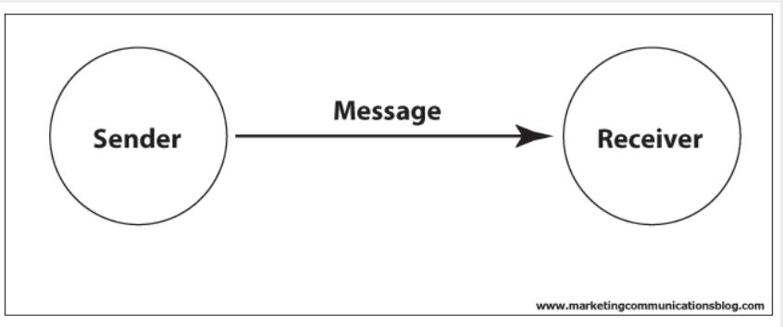
What is Communication?
Communication is the act of sharing or exchanging the information, ideas or feelings.

Slide 4
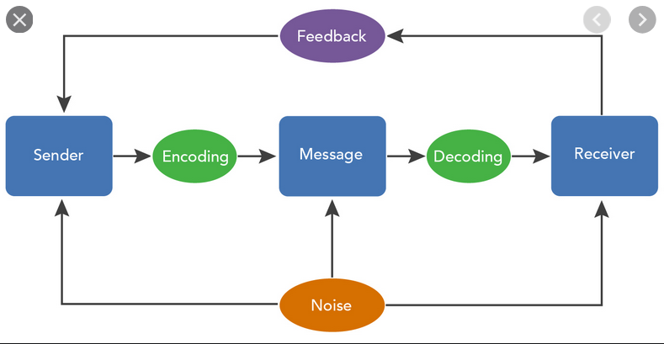
Process Of Communication

Slide 5
Types of communication
There are 2 types of communication:
1. Verbal communication refers to the production of spoken language to send an intentional message to a listener.
2. Non-verbal communication includes facial expressions, the tone and pitch of the voice, gestures displayed through body language and the physical distance between the communicators.

Slide 6
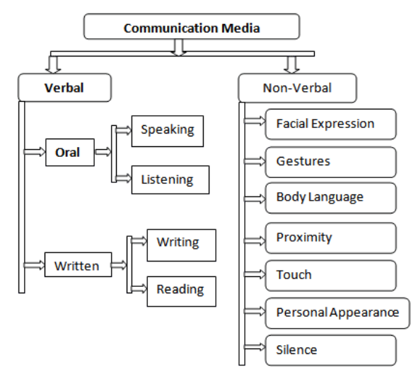
Types of Communication

Slide 7

Spontaneous speaking
What is Spontaneous Speaking?
Spoken language that occurs without prompting or during an unstructured conversation.
Examples: General Conversations, Personal Interviews, Networking sessions etc.

Slide 8
Why is spontaneous speaking an important aspect of business communication?
Business Communication is the process of Communicating in a formal business environment through planned channels of communication.
Spontaneous speaking skills help the members of the organisation to communicate effectively and efficiently within the organisation and outside the organisation to ensure the smooth running of operations.
Eg:
Sales Teams: makes sales calls, meetings etc.
PR Teams: communicate with people outside the organisation and act as the company spokespersons.

Slide 9

Problems faced during spontaneous speaking
1. Fear
2. Nervousness
3. Uneasiness
4. Sense of Insecurity
5. Stomach Gurgling
6. Nausea
7. Perspiration

Slide 10

Reason?!
Anxiety is your body's natural response to stress. It's a feeling of fear or apprehension about what's to come.

Slide 11

Anxiety Management
It is important to have a control over anxiety in order to remove any hindrances that one’s brain causes when he/she is in the spotlight.
The Techniques for anxiety management:
1. Greet your anxiety
2. Spontaneous speaking is a conversation not performance
3. Orientation of time (Be in the present)

Slide 12
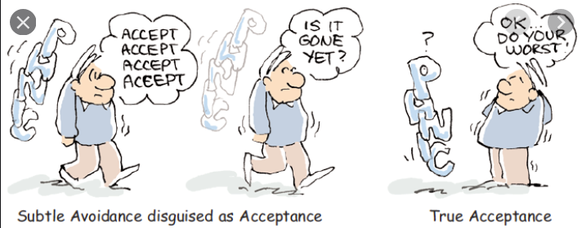
Greet your anxiety
Welcome your anxiety, accept and normalise it.
Try to get anxiety in your comfort zone.
Don’t be overwhelmed.
Stay calm.

Slide 13

Conversation not performance
Train yourself into thinking of spontaneous speaking as an opportunity to convey your thoughts with others.
Interact with the audience, ask them questions, engage them in activities to grab their attention and involve them by giving them an opportunity to communicate with you.
Use conversational language. Don’t use language that is highly technical in nature or involves high vocabulary. Communicate using simple terms to be an effective speaker and beat anxiety.

Slide 14

Orientation of time (be in the present)
Anxiety’s sole cause is the unpredictable consequence of the future.
Humans tend to be more pessimistic than optimistic.
Forget about the future, be in the present.
The consequence is a result of your present actions.
ACTIVITY: Tongue Twister!
Tongue twister will make you concentrate on your pronunciation skills, indirectly dragging your mind from thinking about the future to the present and warm up your voice up!!

Slide 15
Ground rules to speaking spontaneously
It is important to be able to convey the message you wanted to convey effectively and spontaneously without compromising any details of the information.
To achieve the same one must follow the ground rules to speak spontaneously:
Get out of your own way.
See speaking as an opportunity and not a challenge.
Slow Down and Listen.
Tell a story

Slide 16
Rule 1: get out of your own way!
1. Expectations are the villain!
Aim to achieve the best but avoid expecting things to happen definitely in the future. Future is unpredictable, don’t pressurise yourself.
2. Train your brain.
Your brain has muscle memory which creates patterns and restricts your vision to just one dimension of things, try to think out of the box by practising.
The restrictive memory causes frictions in the process of spontaneous situations and one ends up putting too much pressure on their brain which will ultimately prevent you from acting spontaneously.

Slide 17
Rule 2: speaking is an opportunity not a challenge
Spontaneous speaking is often thought of as a challenge.
One should disregard that thought and view speaking as an opportunity.
Opportunity is positive and keeps one’s shoulder burden free.
Challenge is negative and makes one fear from failing to communicate effectively.
Examples on how spontaneous speaking is an opportunity:
1. Networking meetings
2. Conferences
3. Career fairs

Slide 18

Rule 2: speaking is an opportunity not a challenge
The secret of success is to be ready when your opportunity Comes.

Slide 19
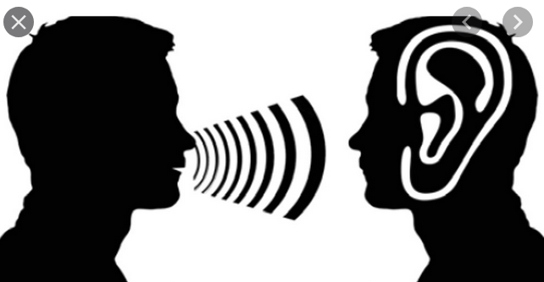
Rule 3: Slow Down and Listen
Cater to the audience by listening to them.
A conversation is a two way process and to communicate effectively, one must know what information he/she needs to give out as per the requirement of the audience.
Don’t practise selective listening as that will make you transmit wrong information and will confuse your audience.

Slide 20

Rule 4: Tell a Story
Structure the information before sharing it with the audience.
Create a flow between them and interrelate information to keep the audience engaged.
Basic structure that one can use to convey information.
Introduction
Body
Conclusion.
Eg: Letters, Reports etc.

Slide 21
THANK YOU!

